Slide 1
Modelling metabolic networks with Stan
Teddy Groves
https://github.com/teddygroves/stancon_2019_metabolic_network_notebook

Slide 2

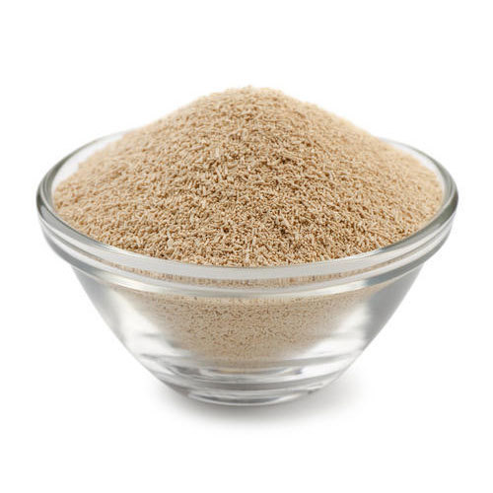
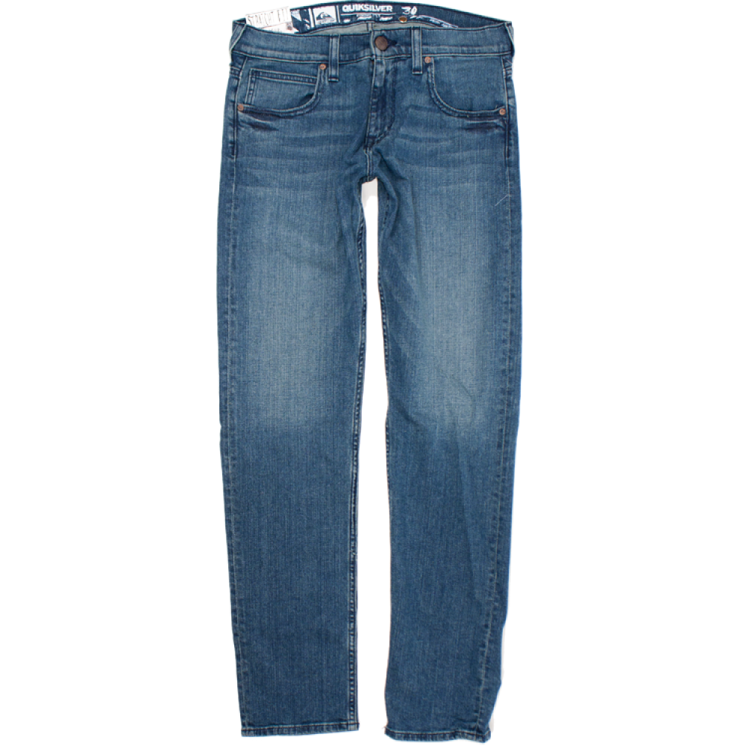
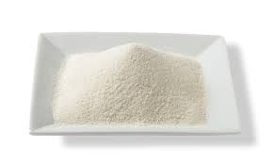

Cell factories
Beer
Indigo
Yeast
Glucose
Spandex
https://github.com/teddygroves/stancon_2019_metabolic_network_notebook

Slide 3
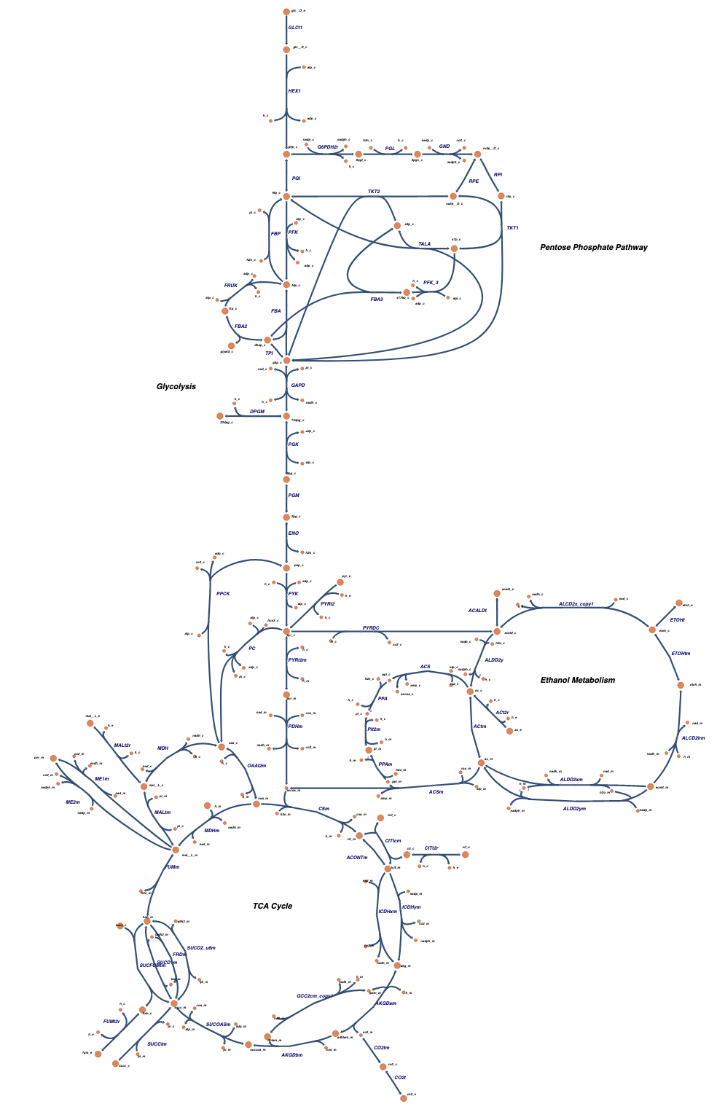
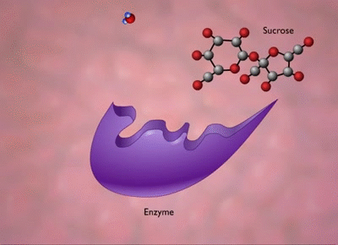
Metabolic networks
Yeast central carbon metabolism
http://bigg.ucsd.edu/models/iMM904
https://github.com/teddygroves/stancon_2019_metabolic_network_notebook

Slide 4
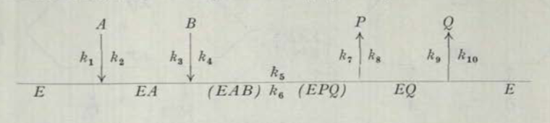
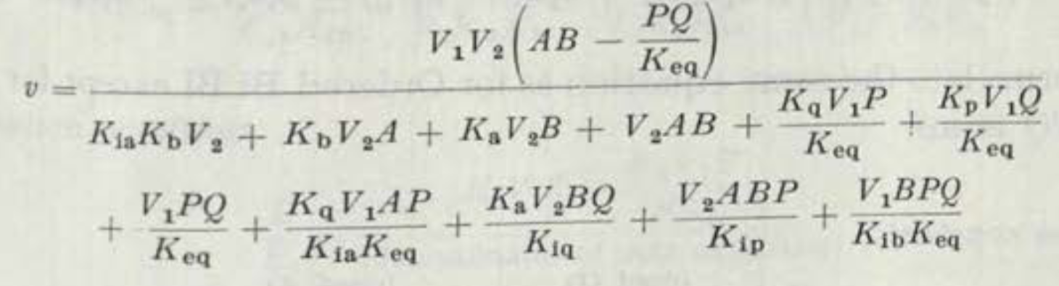
Structural information
Mechanism
Network topology
Rate equation
https://github.com/teddygroves/stancon_2019_metabolic_network_notebook

Slide 5
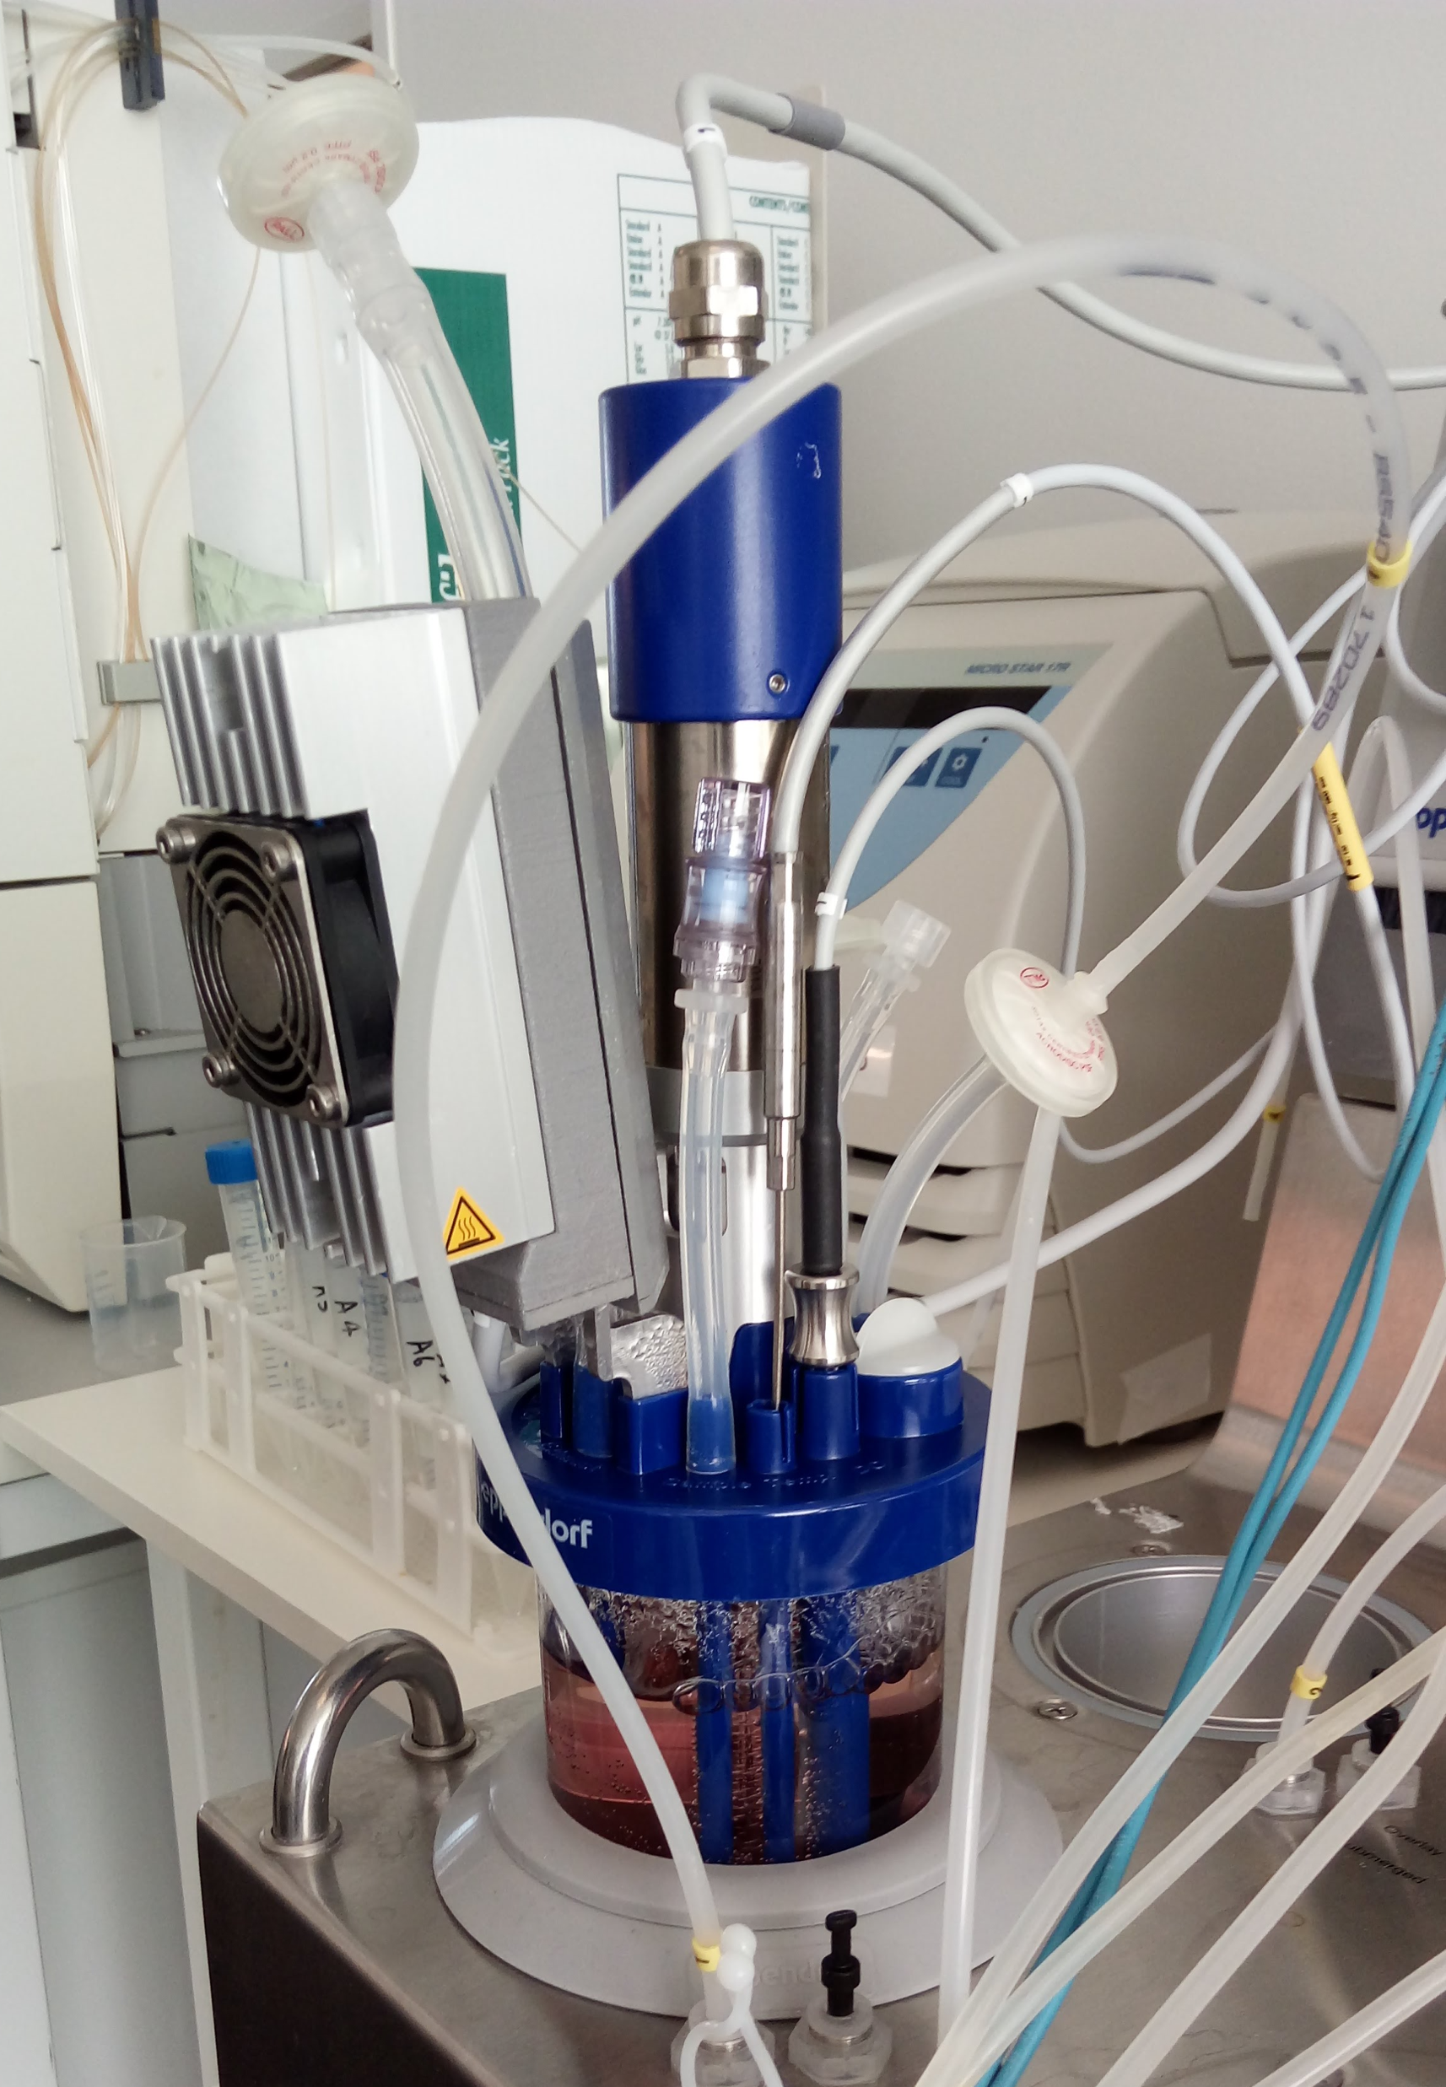
Source of uncertainty: experiments
Metabolomics
Proteomics
Fluxomics
https://github.com/teddygroves/stancon_2019_metabolic_network_notebook

Slide 6

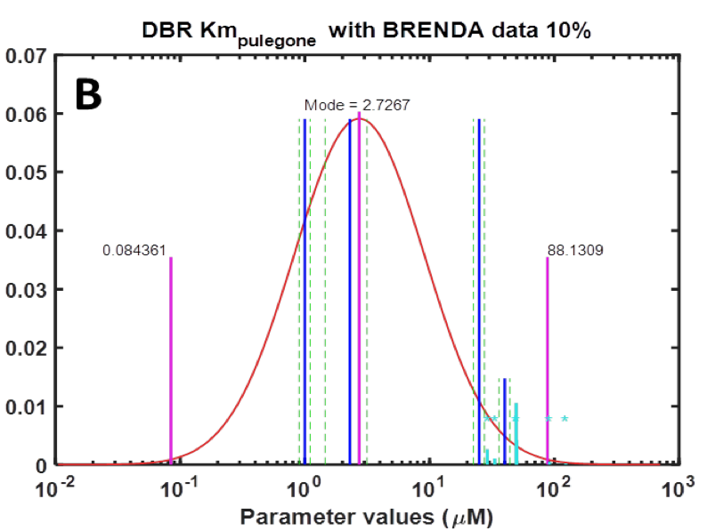

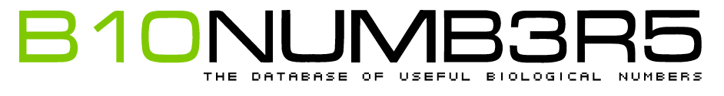
Source of uncertainty: online databases
https://github.com/teddygroves/stancon_2019_metabolic_network_notebook

Slide 7
The plan
Structural information
Parameter information
Experiments
Predicted parameter values
Predicted experimental results
Statistics
https://github.com/teddygroves/stancon_2019_metabolic_network_notebook

Slide 8
The plan
Structural information
Parameter information
Experiments
ODEs
Priors
Likelihood
Predicted parameter values
Predicted experimental results
Stan
https://github.com/teddygroves/stancon_2019_metabolic_network_notebook

Slide 9
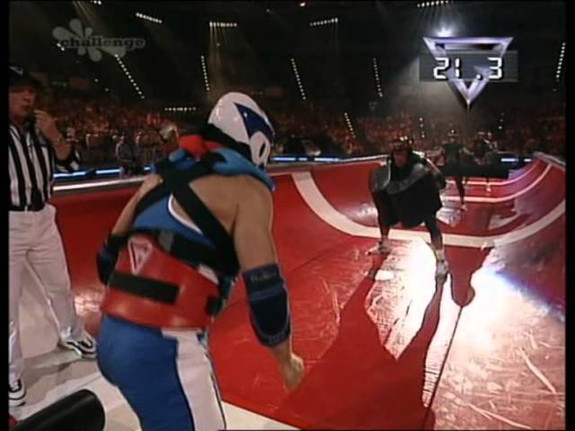
Challenges
Allosteric regulation
Thermodynamics
Big, stiff system of ODEs
https://github.com/teddygroves/stancon_2019_metabolic_network_notebook

Slide 10
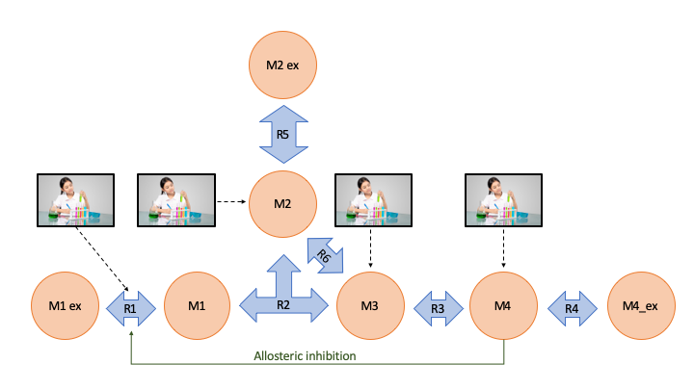
A simple reaction network
https://github.com/teddygroves/stancon_2019_metabolic_network_notebook

Slide 11
A simple reaction network
real[] get_odes(real[] fluxes){
return {
1*fluxes[1]-1*fluxes[2],
0,
1*fluxes[2]-1*fluxes[5]-1*fluxes[6],
1*fluxes[2]-1*fluxes[3]+1*fluxes[6],
1*fluxes[3]-1*fluxes[4],
0,
0
};
}
https://github.com/teddygroves/stancon_2019_metabolic_network_notebook

Slide 12
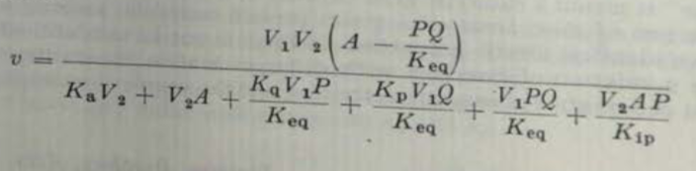
How we represent rate equations
real ordered_unibi(real A, real P, real Q, real V1, real V2, real Ka,
real Kp, real Kq, real Kia, real Kip, real Kiq, real Keq){
real num = V1*V2*(A-P*Q/Keq);
real denom = Ka*V2 + V2*A + Kq*V1*P/Keq + Kp*V1*Q/Keq + V1*P*Q/Keq + V2*A*P/Kip;
return num / denom;
}
https://github.com/teddygroves/stancon_2019_metabolic_network_notebook

Slide 13
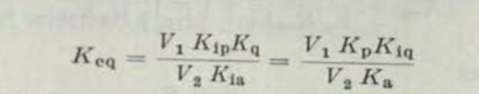
How we represent thermodynamic constraints
real get_Kip_ordered_unibi(real Keq, real Kia, real Kq, real V1, real V2){
return Keq*Kia*V2 / (Kq*V1);
}
real get_Kiq_ordered_unibi(real Keq, real Ka, real Kp, real V1, real V2){
return Keq*V2*Ka / (V1*Kp);
}
https://github.com/teddygroves/stancon_2019_metabolic_network_notebook

Slide 14
How we represent allosteric regulation
real get_regulatory_effect(real[] activator_concentration,
real[] inhibitor_concentration,
real free_enzyme_ratio,
real[] dissociation_constant_r,
real[] dissociation_constant_t,
real transfer_constant){
real Q_num = size(inhibitor_concentration) == 0 ? 1 :
1 + sum(to_vector(inhibitor_concentration) ./ to_vector(dissociation_constant_t));
real Q_denom = size(activator_concentration) == 0 ? 1 :
1 + sum(to_vector(activator_concentration) ./ to_vector(dissociation_constant_r));
real Q = transfer_constant * free_enzyme_ratio * Q_num / Q_denom;
return inv(1 + Q);
}
https://github.com/teddygroves/stancon_2019_metabolic_network_notebook

Slide 15
How we represent steady state quantities
concentration[,e] = integrate_ode_bdf(steady_state_equation,
initial_concentration,
initial_time,
{steady_time},
kinetic_parameter,
known_reals[,e],
known_ints,
rel_tol, abs_tol, max_steps)[1];
flux[,e] = get_fluxes(concentration[,e], kinetic_parameter, known_reals[,e]);
https://github.com/teddygroves/stancon_2019_metabolic_network_notebook

Slide 16
How we represent measurements
concentration_measurement ~ lognormal(log(concentration_hat), concentration_measurement_scale);
flux_measurement ~ normal(flux_hat, flux_measurement_scale);
https://github.com/teddygroves/stancon_2019_metabolic_network_notebook

Slide 17
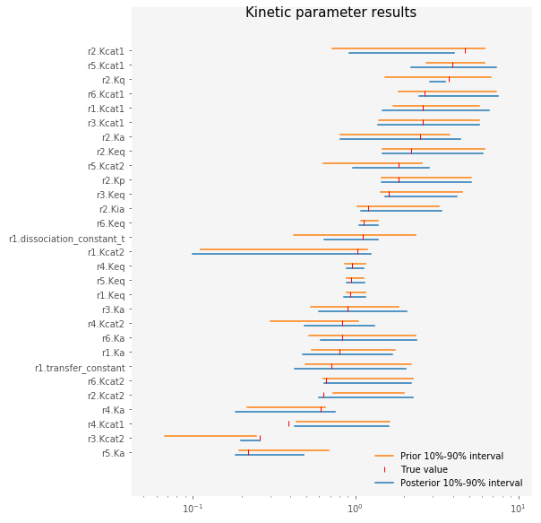
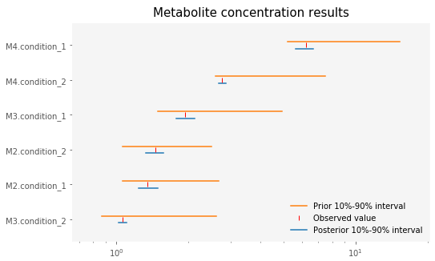
Results
https://github.com/teddygroves/stancon_2019_metabolic_network_notebook

Slide 18
Next hurdle: performance (please help!)
How to exploit sparse ODE Jacobians?
How to do fewer ODE solves?
What can we parallelise?
https://github.com/teddygroves/stancon_2019_metabolic_network_notebook

Slide 19
References
Rate equations
Cleland, W. W. (1963). The kinetics of enzyme-catalyzed reactions with two or more substrates or products: I. Nomenclature and rate equations. Biochimica et Biophysica Acta (BBA) - Specialized Section on Enzymological Subjects, 67(), 104–137. http://dx.doi.org/10.1016/0926-6569(63)90211-63
Enzyme kinetics in general
Saa, P. A., & Nielsen, L. K. (2017). Formulation, construction and analysis of kinetic models of metabolism: A review of modelling frameworks. Biotechnology Advances, 35(8),981–1003. http://dx.doi.org/10.1016/j.biotechadv.2017.09.005
Allosteric regulation
Popova, S. V., & Sel'kov, E. E. (1975). Generalization of the model by monod, wyman and changeux for the case of a reversible monosubstrate reaction. FEBS Letters, 53(3), 269–273. http://dx.doi.org/10.1016/0014-5793(75)80034-2
Saa, P., & Nielsen, L. K. (2015). A General Framework for Thermodynamically Consistent Parameterization and Efficient Sampling of Enzymatic Reactions. PLOS Computational Biology, 11(4),1004195. http://dx.doi.org/10.1371/journal.pcbi.1004195
https://github.com/teddygroves/stancon_2019_metabolic_network_notebook

